Slide 1
Survival Analysis
In many medical studies, the primary endpoint is time until an event occurs (e.g. death, remission)
Data are typically subject to censoring when a study ends before the event occurs
Survival Function - A function describing the proportion of individuals surviving to or beyond a given time. Notation:
  T ≡ survival time of a randomly selected individual
  t ≡ a specific point in time.
  S(t) = P(T > t) ≡ Survival Function
  λ(t) ≡ instantaneous failure rate at time t aka hazard function

Slide 2
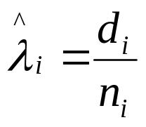
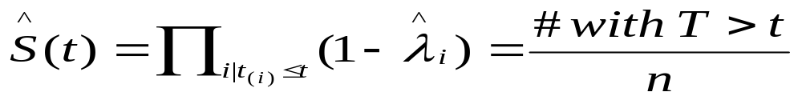
Kaplan-Meier Estimate of Survival Function
Case with no censoring during the study (notes give rules when some individuals leave for other reasons during study)
  Identify the observed failure times: t₍₁₎<···<t_{(k)}
  Number of individuals at risk before t_{(i)} ≡ n_{i}
  Number of individuals with failure time t_{(i)} ≡ d_{i}
  Estimated hazard function at t_{(i)}:
Estimated Survival Function at time t
(when no censoring)

Slide 3
Example - Navelbine/Taxol vs Leukemia
Mice given P388 murine leukemia assigned at random to one of two regimens of therapy
  Regimen A - Navelbine + Taxol Concurrently
  Regimen B - Navelbine + Taxol 1-hour later
Under regimen A, 9 of n_{A}=49 mice died on days: 6,8,22,32,32,35,41,46, and 54. Remainder > 60 days
Under regimen B, 9 of n_{B}=15 mice died on days:
8,10,27,31,34,35,39,47, and 57. Remainder > 60 days
Source: Knick, et al (1995)

Slide 4
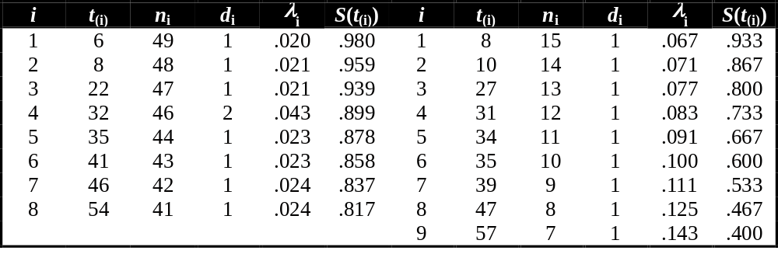
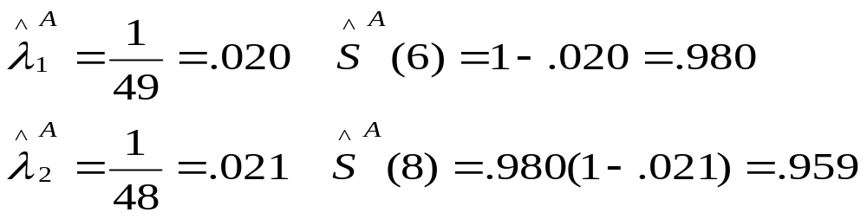
Example - Navelbine/Taxol vs Leukemia
Regimen A
Regimen B

Slide 5
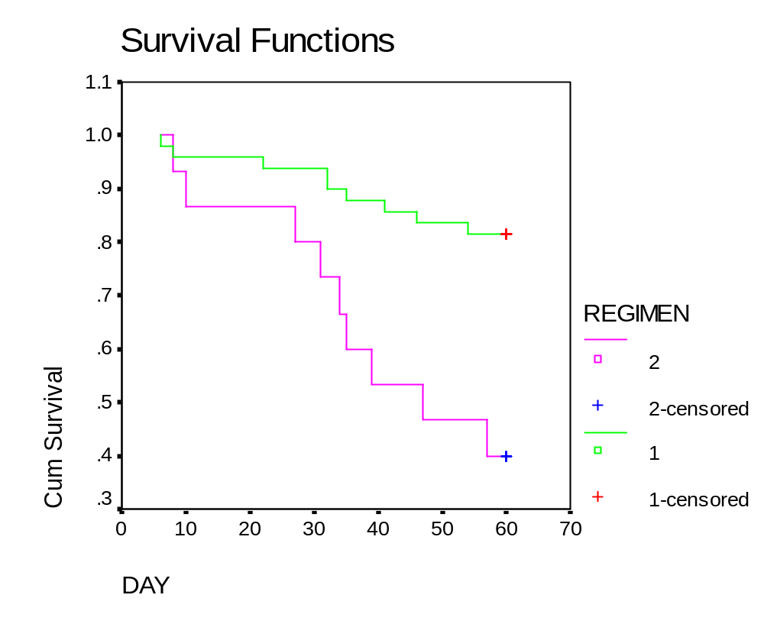
Example - Navelbine/Taxol vs Leukemia

Slide 6
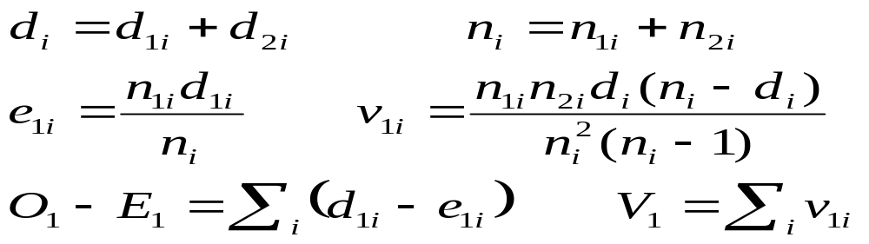
Log-Rank Test to Compare 2 Survival Functions
Goal: Test whether two groups (treatments) differ wrt population survival functions. Notation:
  t_{(i)} ≡ Time of the i^{th} failure time (across groups)
  d_{1i} ≡ Number of failures for trt 1 at time t_{(i)}
  d_{2i} ≡ Number of failures for trt 2 at time t_{(i)}
  n_{1i} ≡ Number at risk prior for trt 1 prior to time t_{(i)}
  n_{2i} ≡ Number at risk prior for trt 2 prior to time t_{(i)}
Computations:

Slide 7
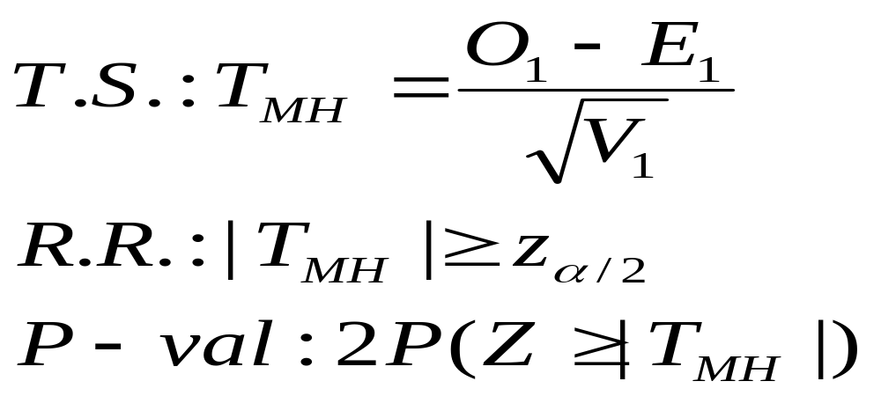
Log-Rank Test to Compare 2 Survival Functions
H₀: Two Survival Functions are Identical
H_{A}: Two Survival Functions Differ
Some software packages conduct this identically as a chi-square test, with test statistic (T_{MH})² which is distributed χ₁² under H₀

Slide 8
Example - Navelbine/Taxol vs Leukemia (SPSS)
Survival Analysis for DAY
Total Number Number Percent
Events Censored Censored
REGIMEN 1 49 9 40 81.63
REGIMEN 2 15 9 6 40.00
Overall 64 18 46 71.88
Test Statistics for Equality of Survival Distributions for REGIMEN
Statistic df Significance
Log Rank 10.93 1 .0009
This is conducted as a chi-square test, compare with notes.

Slide 9
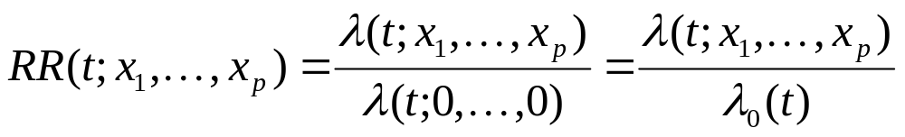
Relative Risk Regression - Proportional Hazards (Cox) Model
Goal: Compare two or more groups (treatments), adjusting for other risk factors on survival times (like Multiple regression)
p Explanatory variables (including dummy variables)
Models Relative Risk of the event as function of time and covariates:

Slide 10
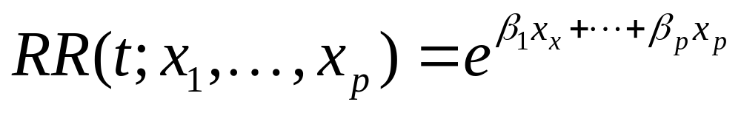
Relative Risk Regression - Proportional Hazards (Cox) Model
Common assumption: Relative Risk is constant over time. Proportional Hazards
Log-linear Model:
Test for effect of variable x_{i}, adjusting for all other predictors:
H₀: β_{i} = 0 (No association between risk of event and x_{i})
H_{A}: β_{i} ≠ 0 (Association between risk of event and x_{i})

Slide 11
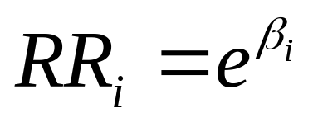
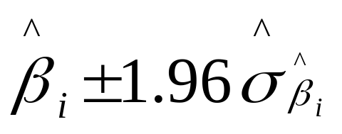
Relative Risk for Individual Factors
Relative Risk for increasing predictor x_{i} by 1 unit, controlling for all other predictors:
95% CI for Relative Risk for Predictor x_{i}:
Compute a 95% CI for β_{i} :
Exponentiate the lower and upper bounds for CI for RR_{i}

Slide 12
Example - Comparing 2 Cancer Regimens
Subjects: Patients with multiple myeloma
Treatments (HDM considered less intensive):
  High-dose melphalan (HDM)
  Thiotepa, Busulfan, Cyclophosphamide (TBC)
Covariates (That were significant in tests):
  Durie-Salmon disease stage III at diagnosis (Yes/No)
  Having received 3⁺ previous treatments (Yes/No)
Outcome: Progression-Free Survival Time
186 Subjects (97 on TBC, 89 on HDM)
Source: Anagnostopoulos, et al (2004)

Slide 13
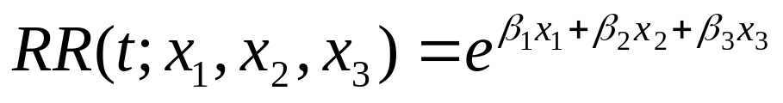
Example - Comparing 2 Cancer Regimens
Variables and Statistical Model:
  x₁ = 1 if Patient at Durie-Salmon Stage III, 0 ow
  x₂ = 1 if Patient has had ≥ 3 previos treatments, 0 ow
  x₃ = 1 if Patient received HDM, 0 if TBC
Of primary importance is β₃:
β₃ = 0 ⇒ Adjusting for x₁ and x₂, no difference in risk for HDM and TBC
β₃ > 0 ⇒ Adjusting for x₁ and x₂, risk of progression higher for HDM
β₃ < 0 ⇒ Adjusting for x₁ and x₂, risk of progression lower for HDM

Slide 14
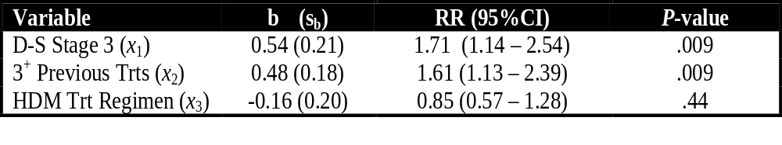
Example - Comparing 2 Cancer Regimens
Results: (RR=Relative Risk aka Hazard Ratio)
Conclusions (adjusting for all other factors):
Patients at Durie-Salmon Stage III are at higher risk
Patients who have had ≥ 3 previous treatments at higher risk
Patients receiving HDM at same risk as patients on TBC

